Slide 1
CHICAGO NEIGHBORHOOD BUSINESS ANALYSIS

Slide 2
INTRODUCTION
Most populous city in the state of Illinois
247 neighborhoods in 77 community areas
Interest to entrepreneurs whom are planning to start a new business in the city of Chicago
Also for people whom are relocation to/within Chicago

Slide 3
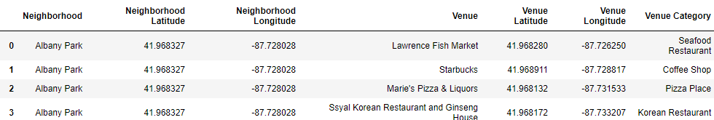
DATA ACQUISITION & CLEANING
Neighborhoods & Community Areas obtained from Wikipedia
Coordinates for each neighborhood obtained with GoogleMaps API from a Google Developer account
Coordinates of different venues in each neighborhood along with their venue types are leveraged using Foursquare API from a Foursquare Developer account

Slide 4
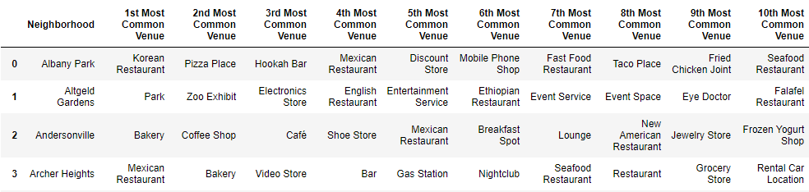
DATA MANIPULATION
353 different types of businesses
Determine frequency of each business type in a particular neighborhood
Extract top ten most frequent business in a particular neighborhood based on frequency

Slide 5
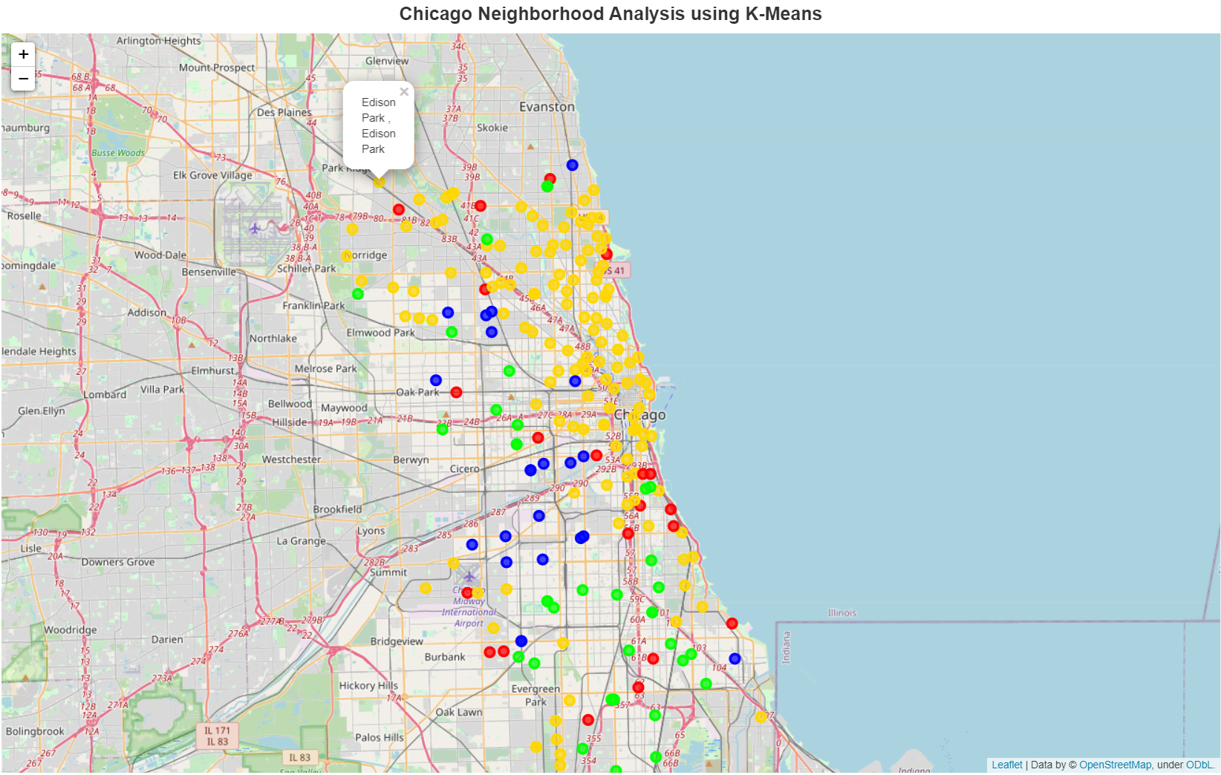
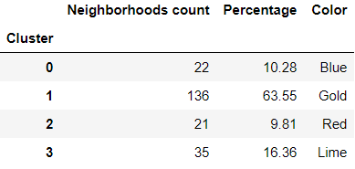
K-MEANS CLUSTERING
More than half of the neighborhoods are similar (65% in Cluster 1)

Slide 6


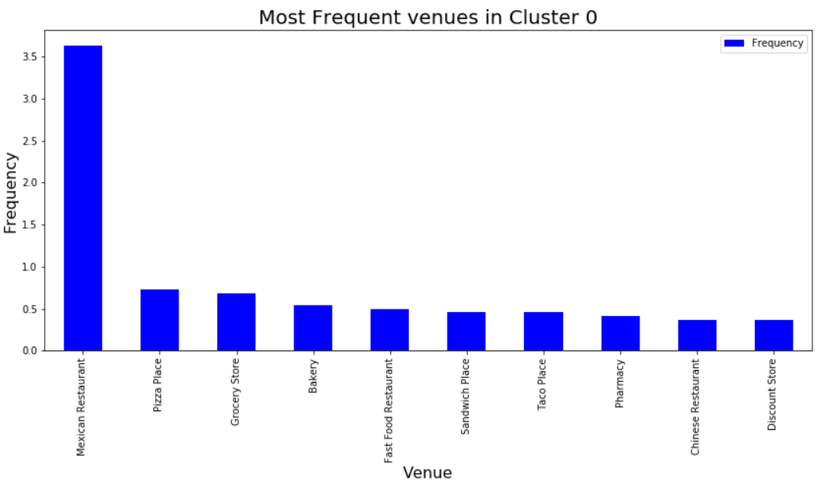


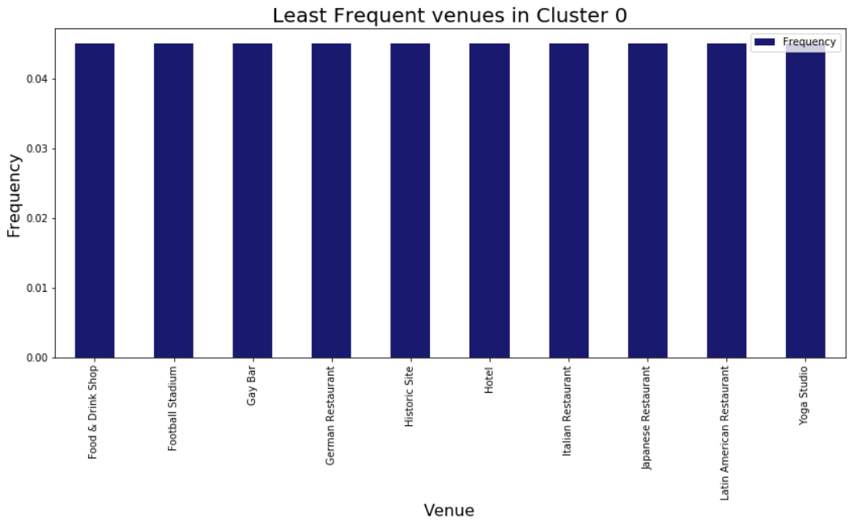

CLUSTER 0

Slide 7
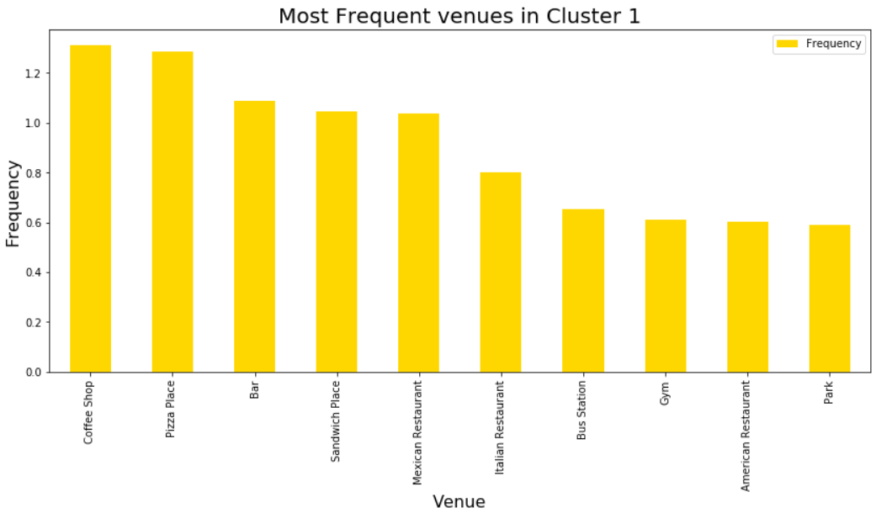
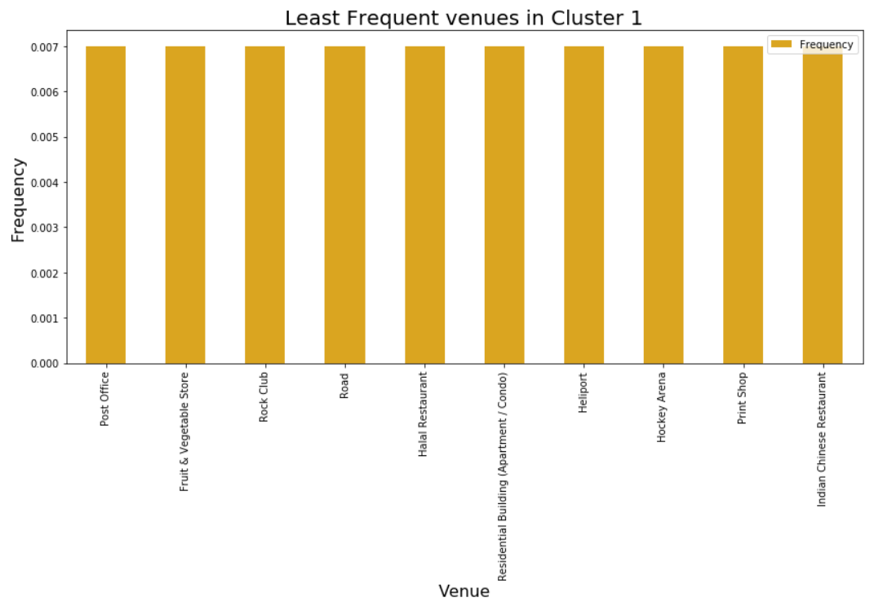
CLUSTER 1

Slide 8
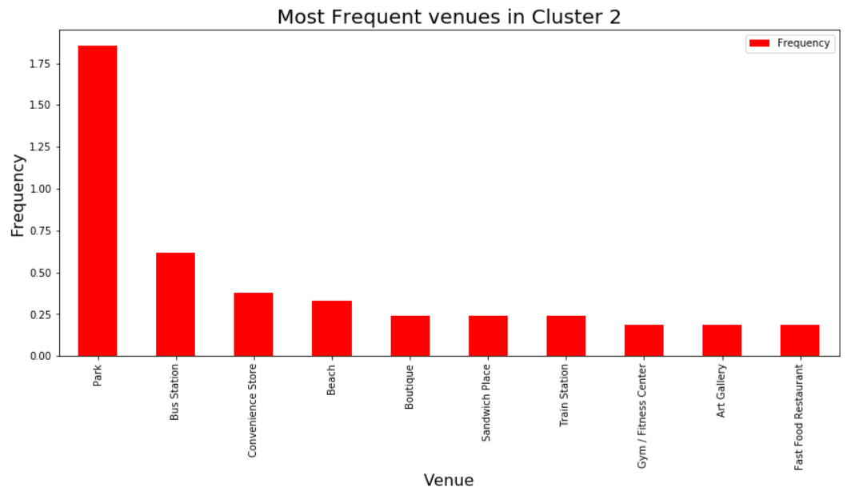
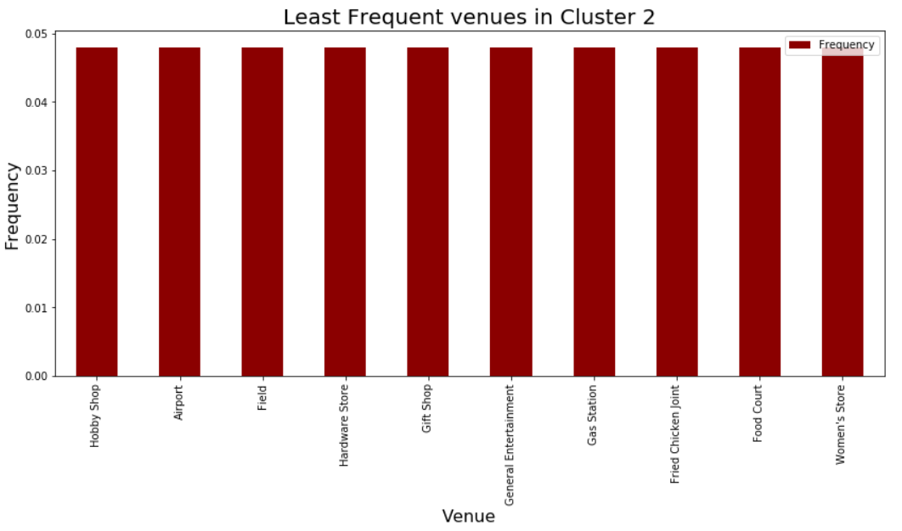
CLUSTER 2

Slide 9
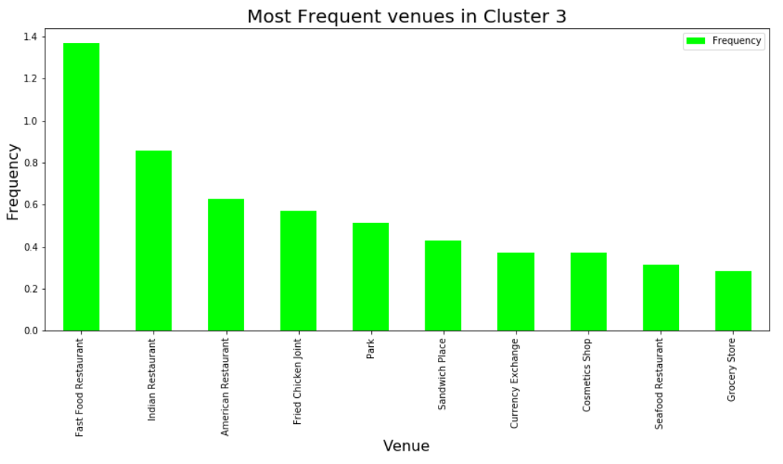
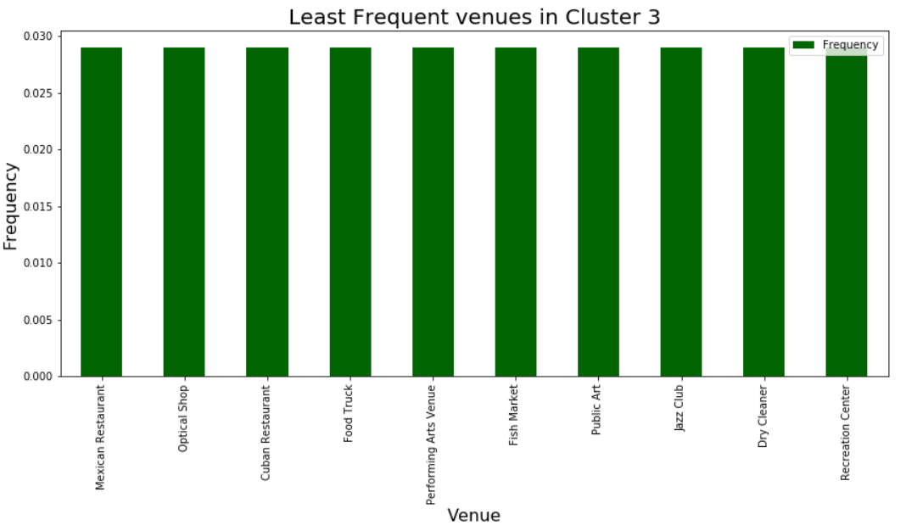
CLUSTER 3

Slide 10
INFERENCES
Mexican restaurant highly frequent in clusters 0 & 1 while less frequent in cluster 3
Fried chicken joint highly frequent in cluster 3 but less frequent in cluster 2
Italian restaurants less frequent in cluster 0
The less frequent businesses can be started in corresponding cluster of neighborhoods due to their scarcity which would result in lower competitions

